Slide 1
The oscars

Slide 2
Data acquisition
We crawled movies data from IMDB site.
Data about all movies from IMDB genre by genre from this link.
Code In 2.
Data about nominee movies from IMDB from this link.
Code In 4.
We created Row Data frame from this two data sources.
Code In 59.

Slide 3
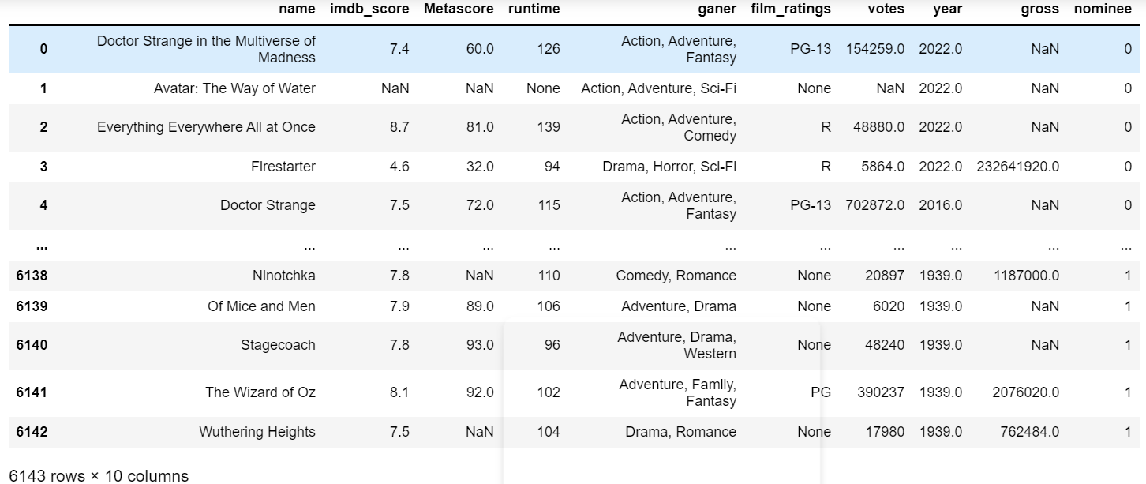
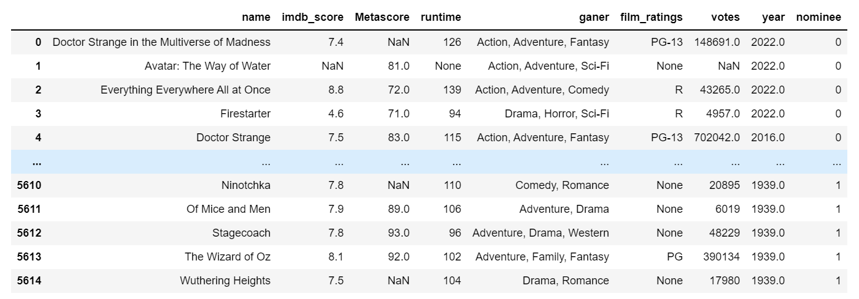



The Row Data frame
Data size:61,430

Slide 4
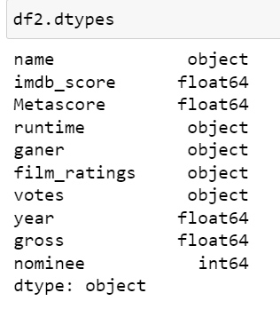
The Row Data frame
Column data types:
Df columns:
Name- the name of the movie (to detect duplicated rows).
Imdb score-imdb ranking of the movie.
Metascore –the Metascore of the movie.
Runtime- the length of the movie
Film rating- the legal age you can see the movie.
Year – the publish year of the movie.
Gross- the gross of the movie.
Nominee- the target column of the df , 1 for movies that are Nominees of the best picture Oscar award.

Slide 5
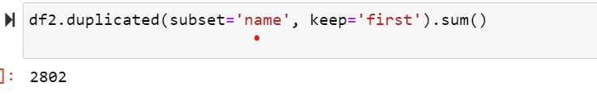
Data analysis and optimization
We do the steps below:
count duplicates- we have 2497 duplicated rows, because of movies that are multi genre movies.

Slide 6
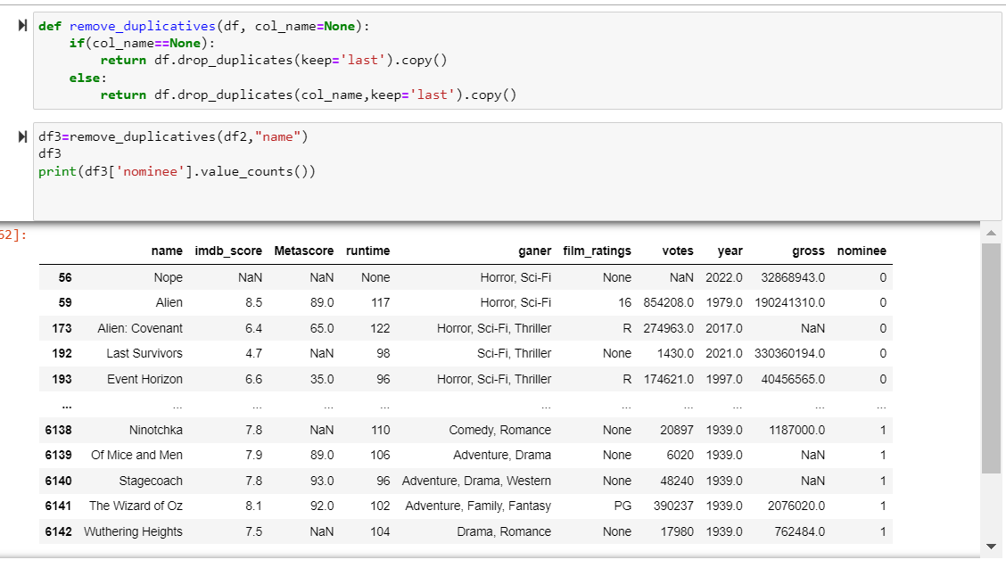
Data analysis and optimization
Removed duplicates-

Slide 7
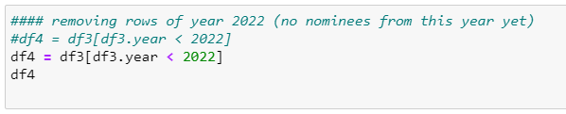
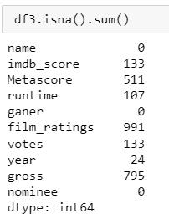
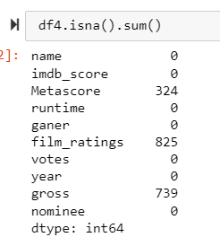
Data analysis and optimization
Remove movies from year 2022 and above from data frame, because that nominees of 2022 and above not yet published.
the result:
to

Slide 8
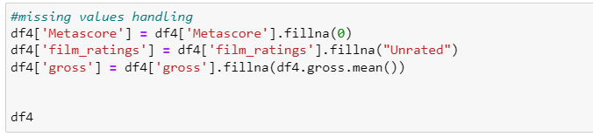
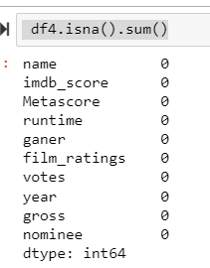
Data analysis and optimization
Fillan missing data-
to

Slide 9
Data analysis and optimization
Remove corrupt rows-
we didn’t use this function because we don’t have null’s in df after the previous steps.
Outliers- we didn’t use this function because , he detects some of the nominees as Outliers because high params, and we didn’t want to drop ani nominee row. We have only 480 nominees.

Slide 10
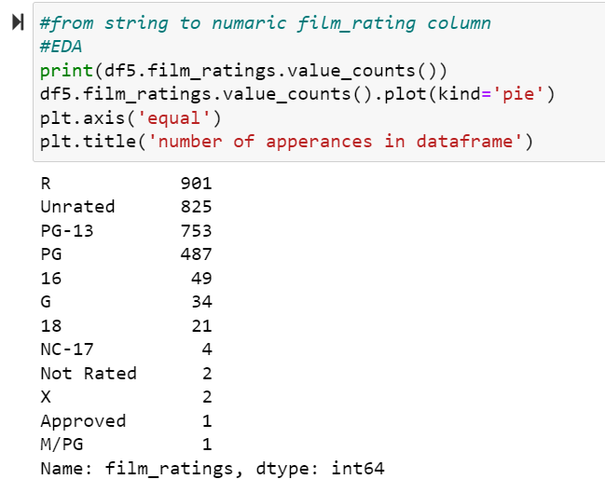
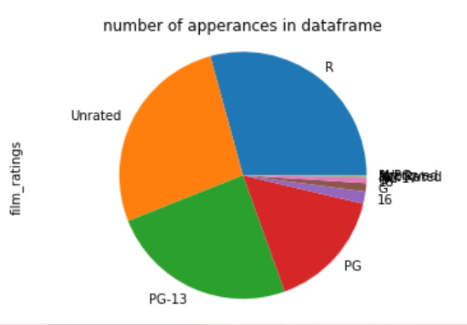
Data handling
Film ratings column: string to numeric-
we can see that the data type of this column is string, but we can Easily transfer it into numeric data type (because the data on this column is scale type string).

Slide 11
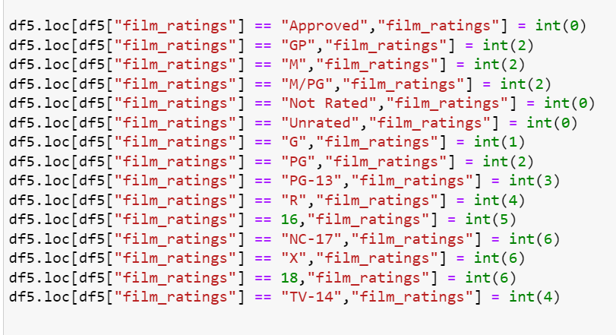
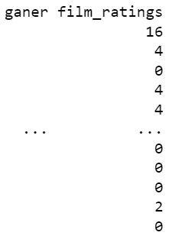
Data handling
Film ratings column: string to numeric-
The result:

Slide 12
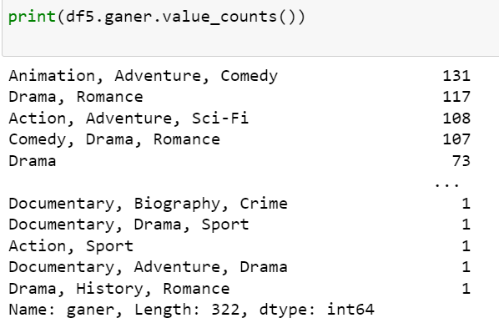
Data handling
Film genre column: string to numeric-
In this column we see the genres of the movie (can be more that one):
We used text analysis techniques to transfer this string to Bolen vector of genres.

Slide 13
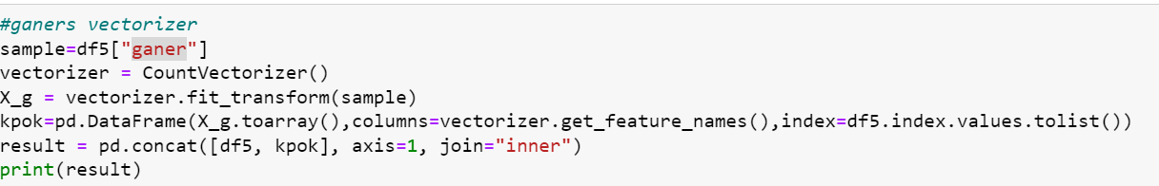
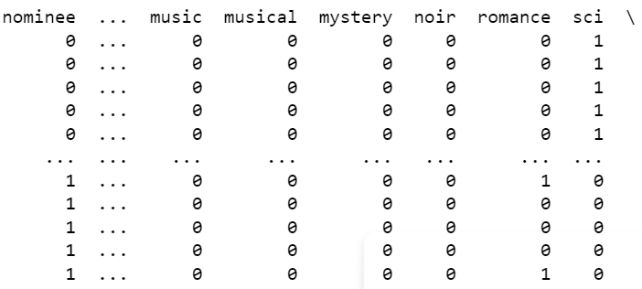
Data handling
Film genre column: string to numeric-
The result:

Slide 14
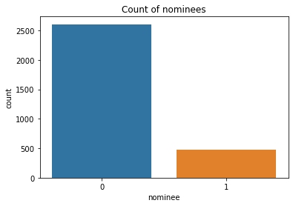
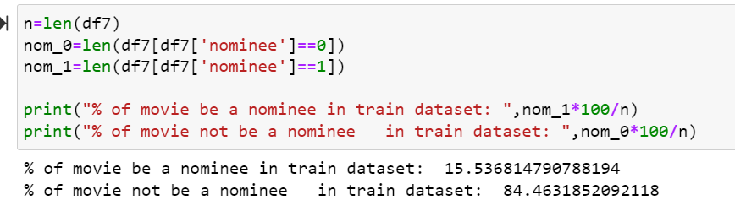
Exploratory Data Analysis and Visualization
We can see that after the cleaning of the data we have around 500 nominee movies and around 2500 not nominee movies.

Slide 15
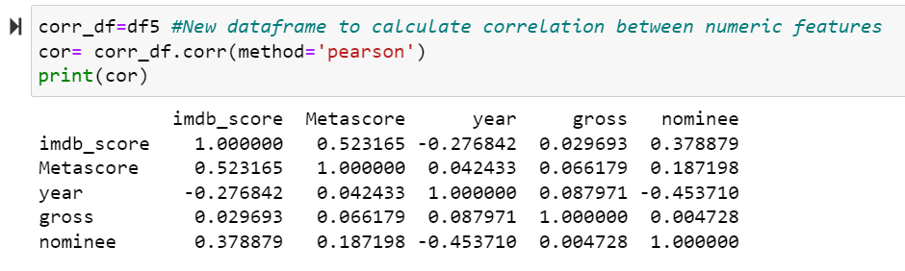
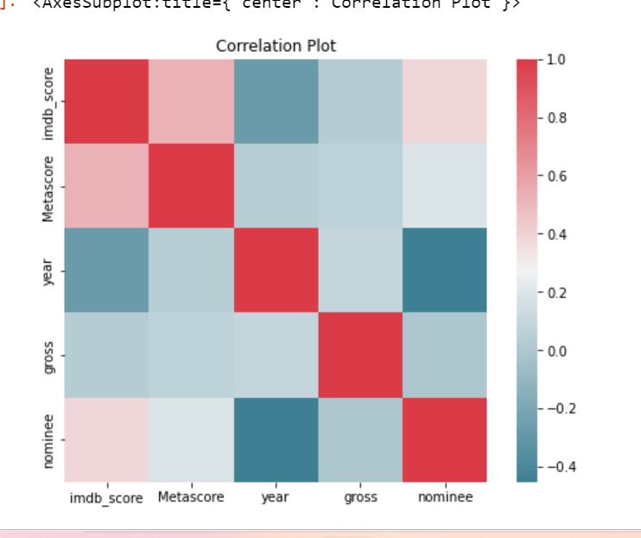
Exploratory Data Analysis and Visualization
Correlations:
We can see that columns with a good correlation is imdb score and metescore 0.523167.

Slide 16
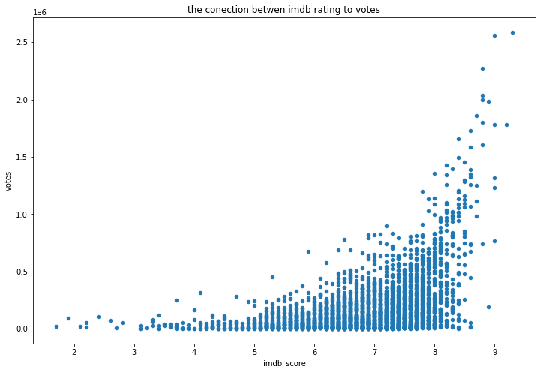
Exploratory Data Analysis and Visualization
We wanted to see the connections between columns:
We can see that the columns of imdb score and votes are very correlated.

Slide 17
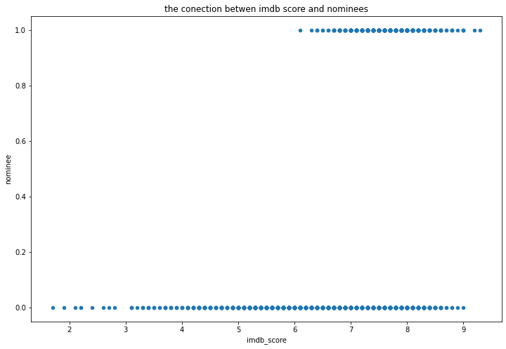
Exploratory Data Analysis and Visualization
The connection between Imdb score to target column:
we can see that all the nominees get
imdb score between 6 to 9.

Slide 18
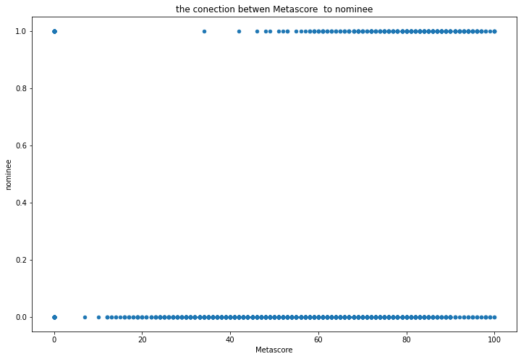
Exploratory Data Analysis and Visualization
The connection between metascore to target column:
in the this graph we can see that
most of nominees get between
40 to 100 score.

Slide 19
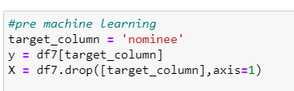
machine learning
Df train test split :

Slide 20
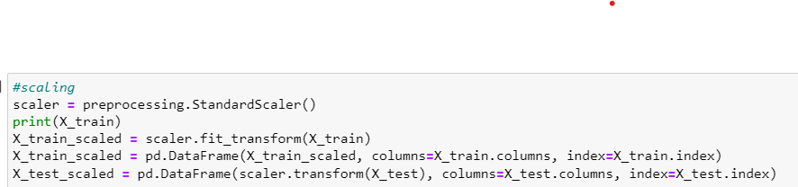
machine learning
We scaled df with the standard scaler:

Slide 21
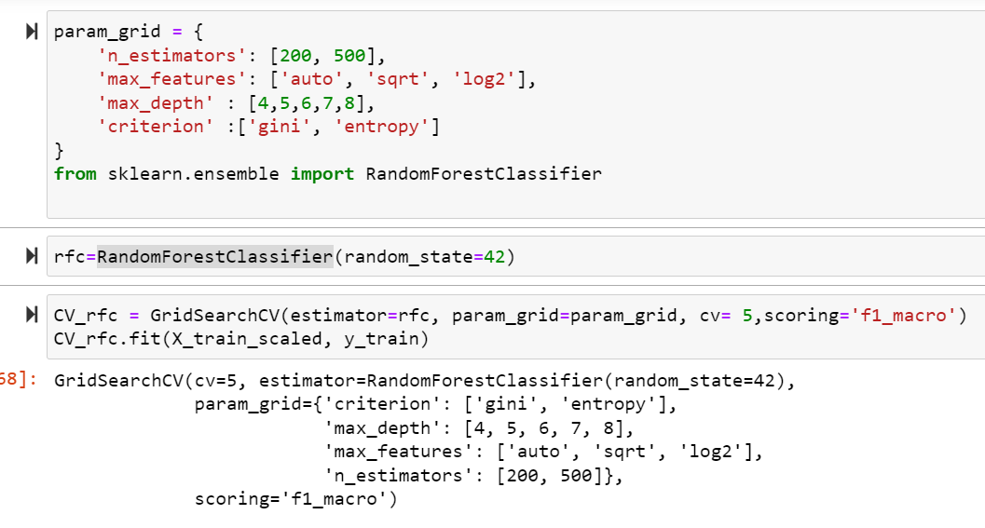
machine learning
We chose RandomForest for the classification (we get with it best f1 score):
To chose hyper params with use of GridSherchCV:

Slide 22
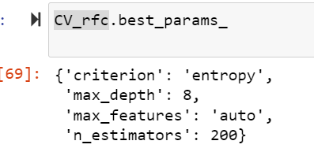
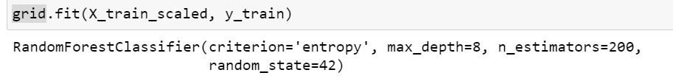




machine learning
And we get that best params is:
We trained the random forest algorithm with tis params:

Slide 23
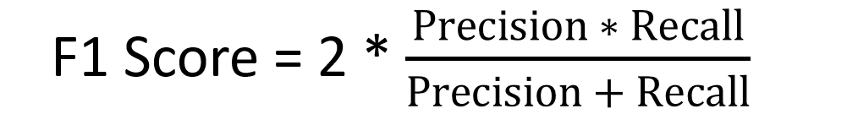
model evaluation
In the project proposal we chose that we want to get best f1 macro score
(because he is a combination of precision and recall )

Slide 24
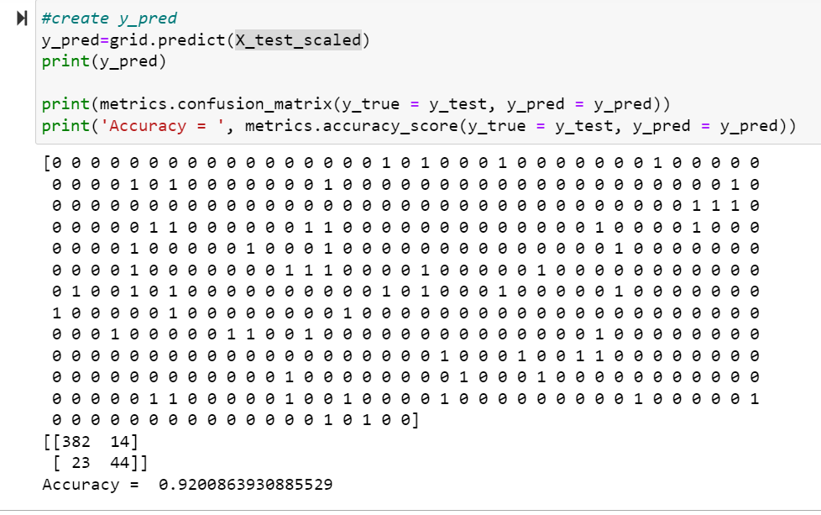

model evaluation
We predicted y_test:
We get accuracy of 0.92 very good score.

Slide 25
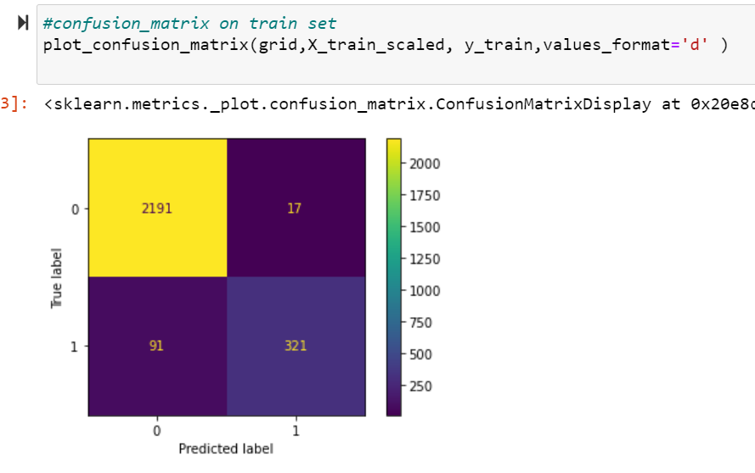

model evaluation
Confusion matrix of test set:
We can see that most of the elements are tp and tn.

Slide 26
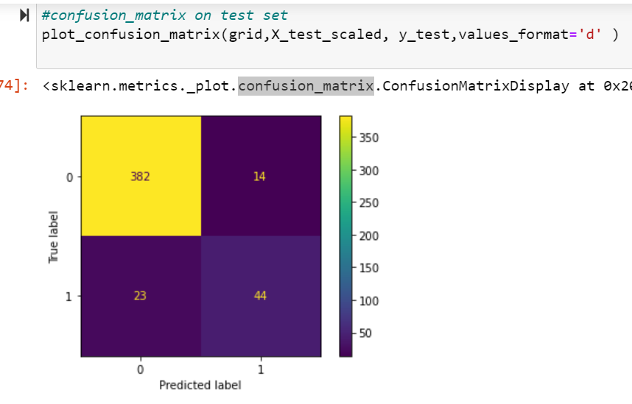
model evaluation
Confusion matrix of test set:
We can see that most of the elements are tp and tn.

Slide 27
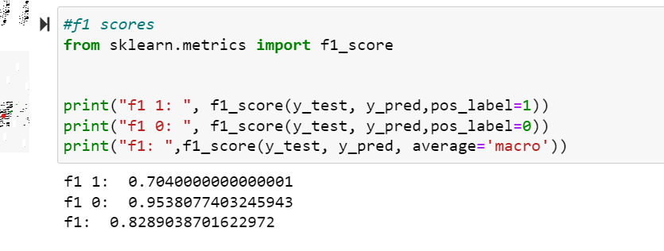
model evaluation
F1 score:
we get good f1 score on
The two types of the
Classification on ones and
On zeros.
And a very macro score of
0.828.

Slide 28
summery
We wanted to see if we can detect which of the movies on imdb site will be a nominee of best picture film Oscar award.
We should here that with a good info crewing and a good data cleaning and handling and use of random forest algorithm we can predict with a good assurance which movie will be a nominee of best picture film Oscar award with 0.828 f1 macro score.

